Slide 1

Oracle 11g: SQL
Chapter 1
Overview of Database Concepts

Slide 2
Objectives
Define database terms and concepts
Identify the purpose of a database management system (DBMS)
Compare traditional file processing to the ‘database approach’
Identify data-related activities in a systems development life cycle
Examine relations as used a DBMS
Oracle 11g: SQL

Slide 3
Database Terminology
Database – logical structure to store data
Database management system (DBMS) – software used to create and interact with the database
Oracle 11g: SQL

Slide 4
Concepts & Definitions
Character Byte
Field Column Attribute
Record Row Tuple
File Table Relation
Notes:
Character, Byte – basic unit of data (letter, digit, symbol, etc.)
Field, Record, File – traditional
Attribute, Tuple, Relation – DB developer
Column, Row, Table – DB user
Field – 1 or more bytes (type, size, format, etc.)
Record – group of related fields
File – group of related records
Database – group of related files

Slide 5
Database Components - Character
Basic unit of data
Can be a letter, digit, or symbol
Oracle 11g: SQL

Slide 6
Database Components - Field
A group of related characters
Represents an attribute or characteristic of an entity
Corresponds to a column in the physical database
Oracle 11g: SQL

Slide 7
Database Components - Record
A collection of fields for one specific entity
Corresponds to a row in the physical database
Oracle 11g: SQL

Slide 8
Database Components - File
A group of records about the same type of entity
Oracle 11g: SQL

Slide 9
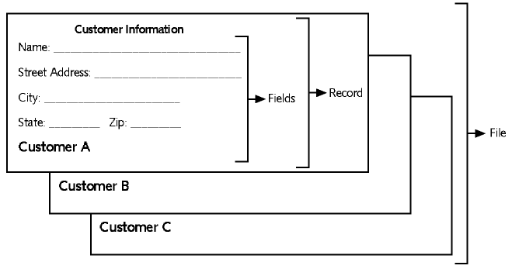
Components Example
Oracle 11g: SQL

Slide 10
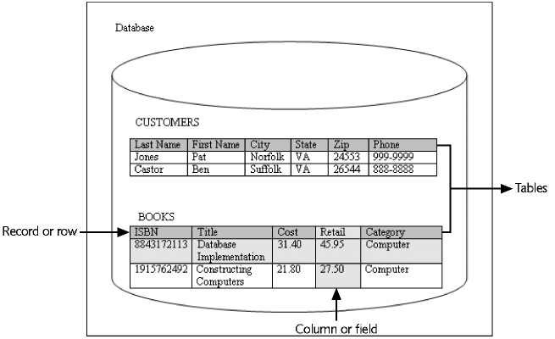
Database Example

Slide 11
Database Management System
Data storage: manage the physical structure of the database
Security: control user access and privileges
Multiuser access: manage concurrent data access
Backup: enable recovery options for database failures
Data access language: provide a language that allows database access
Data integrity: enable constraints or checks on data
Data dictionary: maintain information about database structure
Oracle 11g: SQL

Slide 12
Concepts & Definitions
entity (instance or object)
A person, place, object, event, or concept in the user environment about which the organization wishes to maintain data
entity set (entity type or entity class)
Collection of all related entities
database
Collection of related entity sets
Notes:
entity set - Usually named with a singular noun
Database - Usually organized around a ‘subject’ or ‘business enterprise’
e.g. TRU Colleague – everything to conduct the business of the university (students, courses, faculty, classrooms, etc.)

Slide 13
Concepts & Definitions
entity entity type
Person
Place
Object
Event
Concept
Notes:
People: Bob INSTRUCTOR
Place: OM1772 CLASSROOM
Object: Shah’s DB TEXTBOOK
Event: 1:30 Tues CLASS
Concept: COMP256 COURSE

Slide 14
Concepts & Definitions
data
Facts describing an entity
Notes:
Historically
measures or quantifiers = numbers
characteristics or qualifiers = text
Modern
+ graphics, images, sound, video
electronic representation for visual and auditory senses (sight, hearing)
what about senses of touch, smell, taste?

Slide 15
Concepts & Definitions
attribute
A property or characteristic of an entity
STUDENT | TEXTBOOK | CLASSROOM

Slide 16
Concepts & Definitions
information
Data that have been processed / presented
  “adds value”
  increase the knowledge of the user
Notes:
Placed into context
Summarized
Databases often contain BOTH data and information

Slide 17
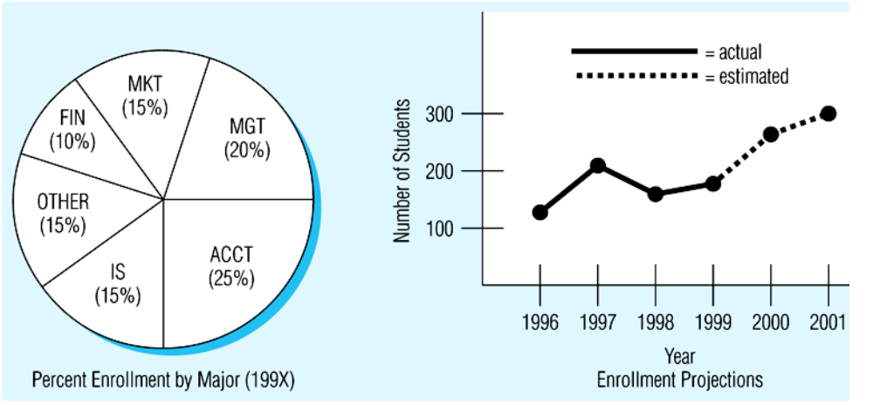
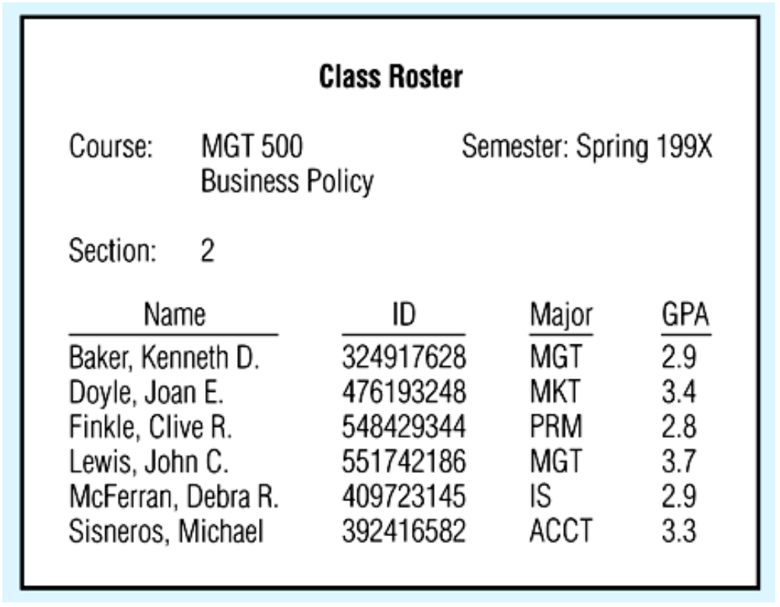
Concepts & Definitions
information
Notes:
Placed into context VS Summarized

Slide 18
Concepts & Definitions
metadata
A way of describing the properties or characteristics of attributes
domain
Set of all possible values for an attribute
Notes:
‘data about data’
Does not include the actual values, although often have representative examples in doc to illustrate
Eg. Course code = 4 letter subject, 3 digit number, 1st digit = normal year of study
Many attributes may share a single domain
Eg. Cell#, FAX#, Pager# all belong to the same domain as Phone#

Slide 19
Concepts & Definitions
relationships
Interactions between entity sets in a given database
Notes:
Usually named with an active verb
Not every entity set is related to all the other entity sets (may be indirectly)
e.g. STUDENT takes COURSE, INSTRUCTOR teaches COURSE, CUSTOMER buys PRODUCT

Slide 20
Concepts & Definitions
relationships
EMPLOYEE
COURSE
Brown
C++
COBOL
Chen
SQL
Geiger
Perl
Thomas
HTML
Wilson
ASP

Slide 21
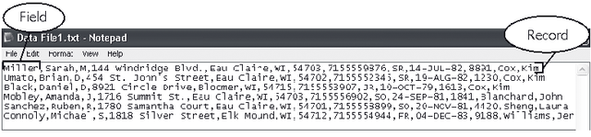
Traditional File Processing
Data was kept in files:
  Each field describes 1 piece of data about an entity
  Fields are by position or separated by commas
  A record is a collection of related fields
  Each record appears as a separate line

Slide 22
Traditional File Processing
Each application has data files that correspond to only that application
Checking
Account
Data
Files
Auto Loan
Data
Files
Checking
Account
Programs
Auto
Loan
Programs
Savings
Account
Data
Files
Savings
Account
Programs
Notes:
Example of Bank accounts
each account was treated as unique
no inter-related processing between chequing / savings

Slide 23
Traditional File Processing
“Legacy systems”
Usually developed data files specific only to the immediate application or department
No thought given to integrating or re-using across a business
Proliferation of data management programs to deal with different file formats
Redundant data stored in many places – inconsistencies grow over time

Slide 24
Database Approach
Emphasizes the integration and sharing of data throughout organization
Fundamental shift to a top-down approach
Tightly linked to what the organization / business is about (aka the enterprise)

Slide 25
Database Approach
Database stores all organizational data in a central location
Good design eliminates redundant data, reduces possibility of inconsistent data
Single application called the DataBase Management System (DBMS) performs all routine data handling operations
User
Applications | DBMS | Database
O/S Software
Hardware
Fig 1-1

Slide 26
Database Approach
All applications interface with the same data in a central database
Checking
Account
Programs
Database
Database
Management
System
Auto
Loan
Programs
Savings
Account
Programs

Slide 27
Database Approach
- Advantages
Program-data independence
Decreased data redundancy
Improved data consistency
Improved data accessibility, sharing, responsiveness
Increased productivity for I.S. developers
Reduced program maintenance
Enforcement of standards
Notes:
Decreasing redundancy + Improved consistency → Better quality

Slide 28
Database Approach
- Costs & Risks
New, specialized personnel
Installation and management cost
Conversion cost
Need for explicit backup and recovery
Organizational conflict

Slide 29
SDLC – Data specific activities
Enterprise Modeling
- ERM at a very high subject-oriented level
- Inventory of current, proposed systems
Project Identification
and Selection
Project Initiation
and Planning
Conceptual Data Modeling
- ERD for subject database
Analysis
Logical Database Design
- Normalized, well-structured tables
- Transactions, Views, Integrity, Security
Logical Design
Physical Database Design
- Physical storage considerations
- Define database to DBMS (SQL DDL)
Physical Design
Implementation
Code, Test, Document, Install
Application Programs
Maintenance
Ongoing adaptive changes
Backup / Recovery
Performance Tuning

Slide 30
Three schema architecture
One organizational database description
User view 1
(report)
User view 2
(form)
…
User view n
(transaction)
Conceptual
schema
Physical
schema

Slide 31
Three schema architecture
3 different ‘models’ or ‘views’ of a database:
External schema – User view
  What it looks like from the outside
  Some portion required for a user for a process
Conceptual schema
  What it needs to be and do
  Technology independent
Physical or Internal schema
  How it is really put together
  Technology dependent
Notes:
External – forms, reports, etc.
Conceptual – ERD
Physical – SQL

Slide 32
Three schema architecture
Conceptual schema
Understanding of transactions, reports, displays, queries, etc.
Enterprise data model
Develop
conceptual
schema
Develop
user views &
logical DB specs
General understanding
of business / project
database requirements
New user requirements
User views
When conceptual and external
are fully defined
Develop
physical
schema
Hardware architecture,
Physical characteristics of the data
Performance expectations

Slide 33
PROJ2009
PROJ2008
ProjNo | Loc | Customer
1 | Miami | Stocks
2 | Orlando | Allen
3 | Trenton | Smith
4 | Charlotte | Jones
ProjNo | Loc | Customer
1 | Miami | Stocks
3 | Trenton | Smith
5 | Phoenix | Robins
6 | Edison | Shaw
7 | Seattle | Douglas
PARTS
PROJPARTS
PartNo | PartDesc | Vendor | Cost
11 | Nut | Richards | 19.95
22 | Bolt | Black | 5.00
33 | Washer | Mobley | 55.99
ProjNo | PartNo | Qty
1 | 11 | 20
2 | 33 | 5
3 | 11 | 7
1 | 22 | 10
2 | 11 | 3
EMPLOYEE
Empno | Ename | DeptNo | ProjNo | Salary
101 | Carter | 10 | 1 | 25000
102 | Albert | 20 | 3 | 37000
103 | Breen | 30 | 6 | 50500
104 | Gould | 20 | 5 | 23700
105 | Barker | 10 | 7 | 75000
DEPARTMENT
DeptNo | DeptName
10 | Production
20 | Supplies
30 | Marketing

Slide 34
Relational Notation
PROJ2008 (ProjNo, Loc, Customer)
PROJ2009 (ProjNo, Loc, Customer)
PROJPARTS (ProjNo, PartNo, Qty)
PARTS (PartNo, PartDesc, Vendor, Cost)
DEPARTMENT (DeptNo, DeptName)
EMPLOYEE (EmpNo, Ename, DeptNo, ProjNo, Salary)
Fig 1-4

Slide 35
Relational Table Keys
Primary key (PK)
Uniquely identifies a record
Secondary key
Field that could be used as a primary key
Often used for common searches
Surrogate key
Numeric field ‘invented’ for the purpose of being the primary key because no other suitable key exists

Slide 36
Relational Table Keys
Foreign key (FK)
Field in one table that is a primary key in another table (used to link related records)
Composite key
Key made of the combination of two or more fields

Slide 37
Relational Database
Consists of any number of relations / tables, described by a conceptual schema
CUSTOMER
Customer_ID | Customer_Name | Address | …
ORDER
ORDER_LINE
Order_ID | Order_Date | Customer_ID
Order_ID | Product_ID | Quantity
PRODUCT
Product_ID | Product_Description | …

Slide 38
Relational Database
Is it a good idea to create an instance of your relational schema with sample data?
1
2
3
Notes:
Convenient way to check accuracy of design, esp. constraints
Help improve communication with users
Use to develop prototype applications, test queries

Slide 39
Integrity Rules
Purpose is to facilitate maintaining accuracy and integrity of data in the database
  Domain Constraints
  Entity Integrity
  Referential Integrity
  Operational Constraints
Notes:
1,2 within a given relation
3,4 across relations

Slide 40
Domain Constraints
All values that appear in a column of a relation must be from same domain
domain constraint = Specification of the set of values that can be assigned
  domain name
  meaning or description
  data type
  size (length), decimal places, etc.
  allowable values (list or range)

Slide 41
Domain Constraints
Attribute | Domain Name | Domain
Student_ID | Student_IDs | num: size 7
Student_First_Name Faculty_First_Name | First_Names | char: size 25
Work_Phone Home_Phone FAX | Phones | num: size 10 (###) ###-####
Wholesale_Price Retail_Price Discount_Price | Prices | money: 6 digits
Notes:
Notice Domain Name is usually plural.
Not implemented in Oracle.

Slide 42
NULL value
There are cases when an attribute cannot be assigned a value:
  There is no value applicable
    eg. Personal FAX number
  The value is not known when row is created
    eg. GPA for newly registered student
NULL is empty or missing or absent value
Not the same as blank or zero!
    eg. meaning if GPA is NULL versus 0.00
Notes:
A lot of systems specify default/initial values to simplify development
GPA NULL – never been / cannot be calculated
GPA ZERO – failed every course

Slide 43
Entity Integrity
Designed to ensure every relation has a unique primary key as a way of identifying a specific row (row uniqueness property)
No primary key attribute (or component) can be NULL
Notes:
May mean inventing a surrogate key (like Student_Nbr) if none naturally occurs

Slide 44
Referential Integrity
Designed to maintain consistency of relationships between tables
Each foreign key value must match a primary key value in the other relation, or else the foreign key value must be null
  Parent – Child
  eg. cannot create an Order unless Customer exists
  Lookup tables
  eg. 2 letter Province abbreviations

Slide 45
Referential Integrity
Showing Referential Integrity Constraints via Foreign Keys
CUSTOMER
Customer_ID | Customer_Name | Address | …
ORDER
Order_ID | Order_Date | Customer_ID
ORDER_LINE
Order_ID | Product_ID | Quantity
PRODUCT
Product_ID | Product_Description | …
Notes:
Arrow goes from FK in one relation to PK in another relation

Slide 46
Operational Constraints
Business Rule
  Statement that governs some aspect of the business operation.
  Intended to assert business structure or control / influence behaviour of business
  eg. Person can rent a car only if he/she possesses a valid driver’s license
  eg. Can purchase ticket for All Star Game only if a season ticket holder
Legacy systems implement in procedural logic buried within individual programs
Notes:
Legacy form – tough to recognize, far removed from original business intent

Slide 47
Operational Constraints
(constrained object) (condition) (constraining object(s))
Notes:
Constrained object = entity, attribute, relationship on which operations are to be limited
Constraining object = entity, attribute, relationship that influences the ability to perform an operation on another object
Typically implement as a trigger to be enacted before/after Insert, Update or Delete

Slide 48
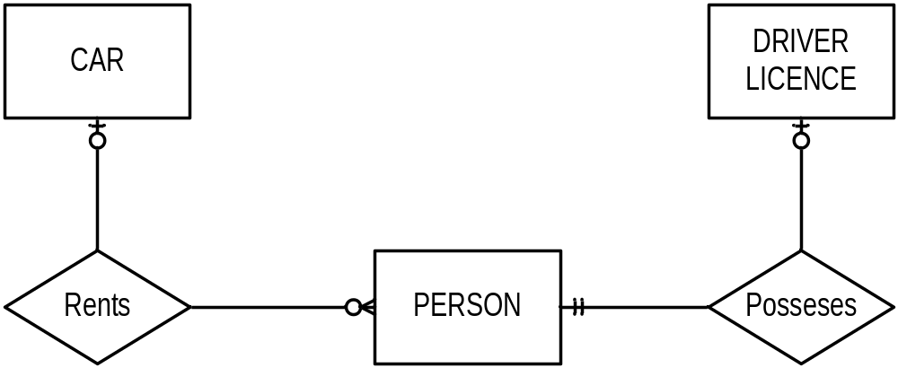
Operational Constraints
  eg. Person can rent a car only if he/she possesses a valid driver’s license
Notes:
Rents is “constrained”
Possesses is “constraining”
Some tools allow you to link with a dotted line

